Slide 1
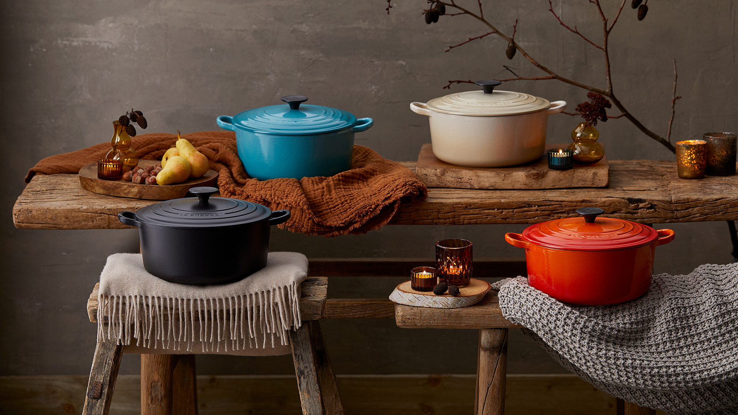
Digital Brochure Showcasing a Selection of Items Available in the Le Creuset Boutique

Slide 2
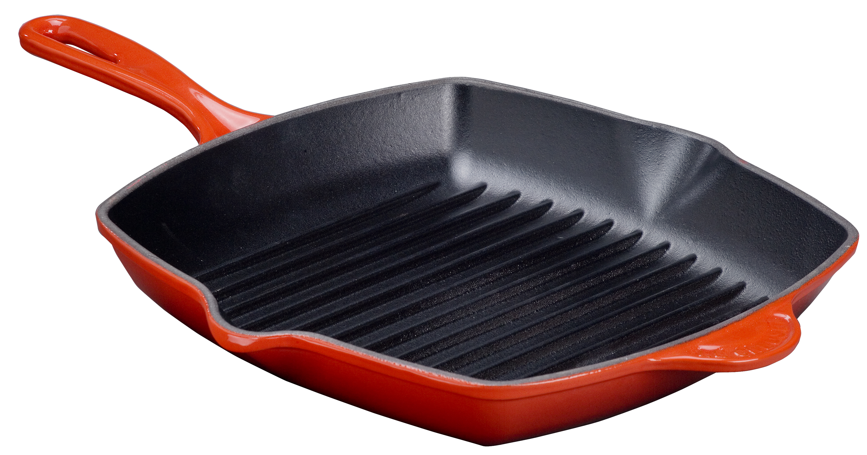
Cast Iron – Available in a selection of Sizes and colours
=[-
Oval Casserole
25cm, RRP €239, Kildare price €159.30 27cm, RRP €265, Kildare price €176.65 and 29cm RRP €305, Kildare price €203.30
Shallow Casserole
26cm RRP €239, Kildare price €159.30, and 30cm RRP €269, Kildare price €179.30
Round Casserole
20cm RRP €219, Kildare price €146, 22cm RRP €249, Kildare price €166, 24cm RRP €275, Kildare price €183.30, 26cm RRP €309, Kildare price €206, and 28cm RRP €339, Kildare price €226.
Square Grillit
26cm RRP €145,
Kildare price €96.65

Slide 3
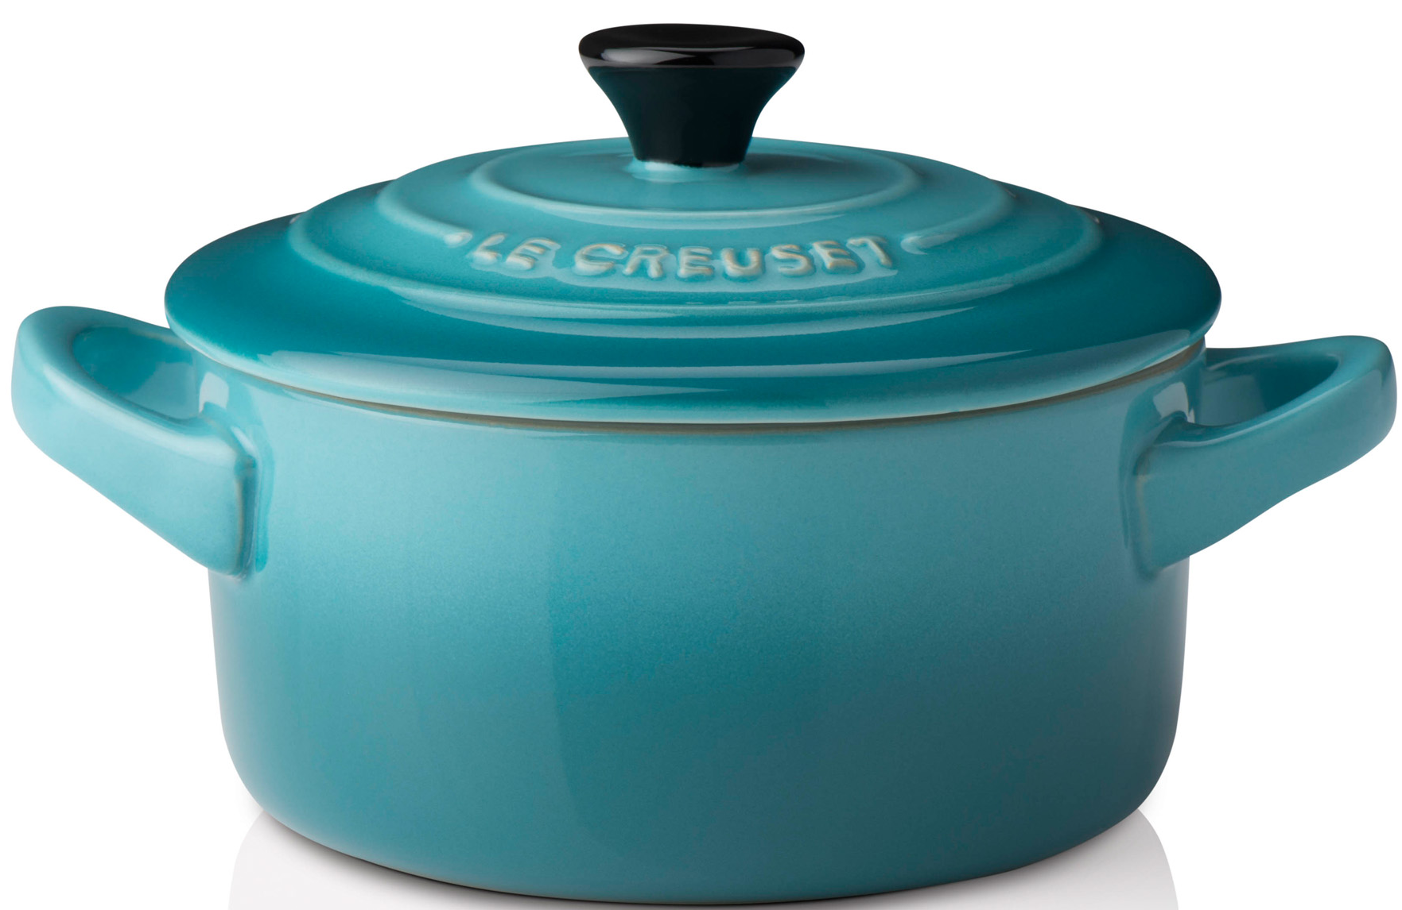
Stoneware and Mills– Available in a selection of Sizes and colours
Mugs
20cm RRP €16, Kildare price 3 for 2 €32
Petite Round Casseroles
RRP €23, Kildare price 2 for €30.60
Mills – Salt and Pepper
20cm RRP €72, Kildare price €48

Slide 4
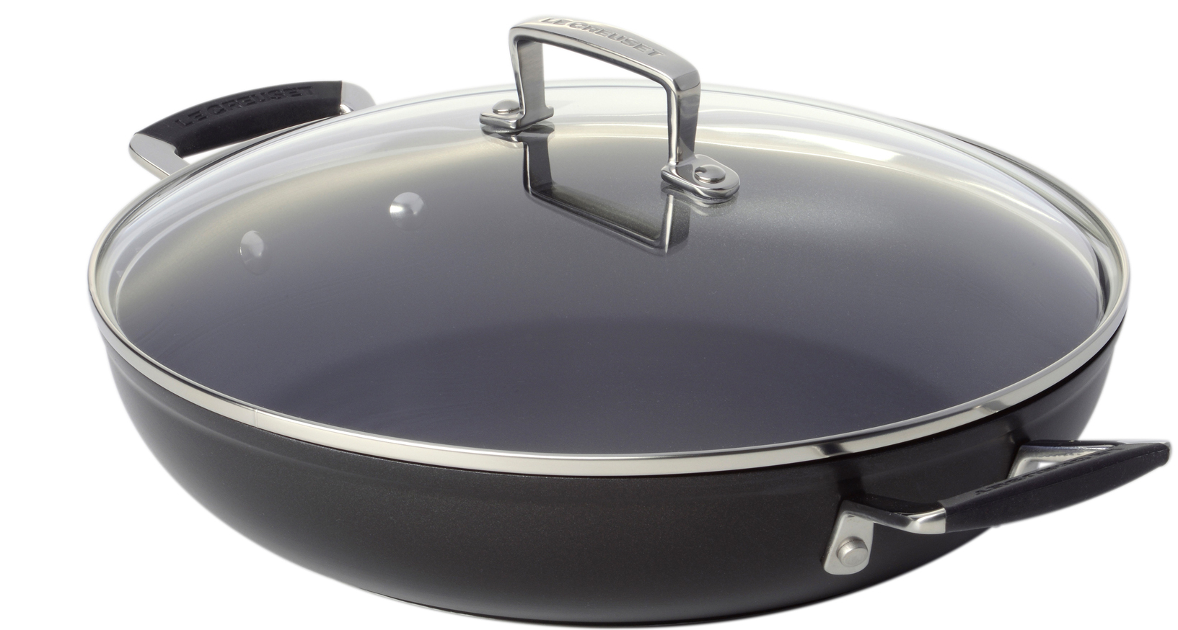
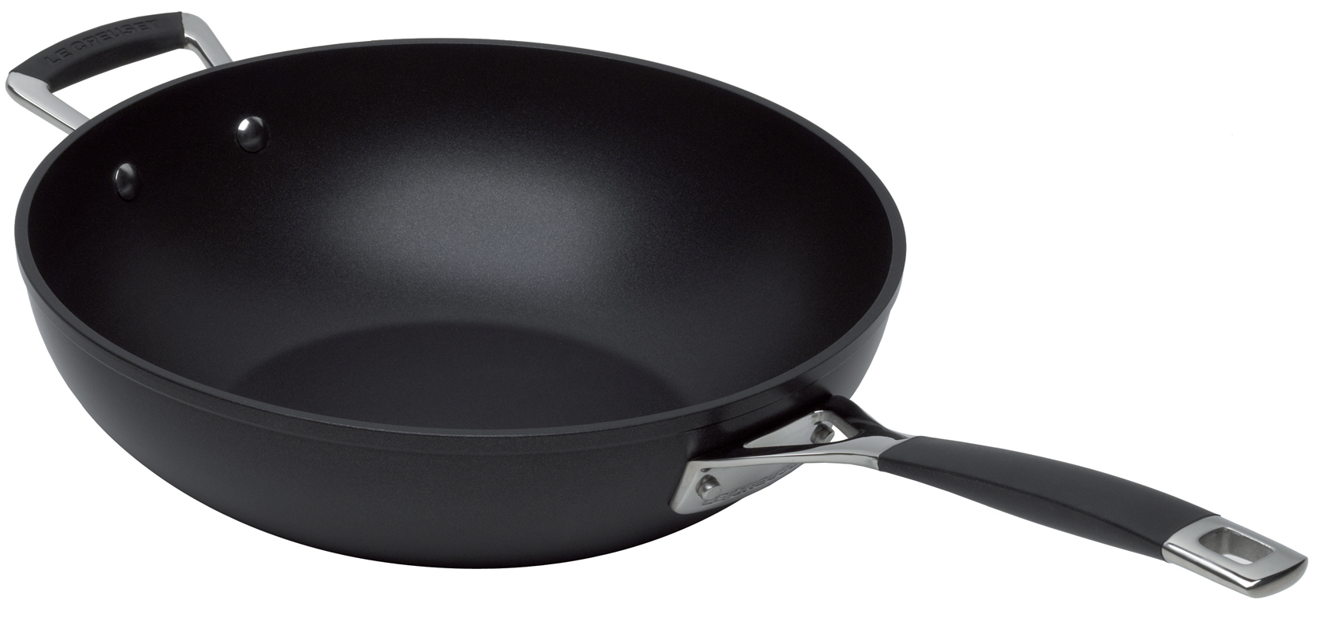
Toughened Non-Stick– Available in a selection of Sizes and Items
30cm Stir Fry Pan
RRP €179, Kildare price €119.30
Shallow Casserole
30cm RRP €185, Kildare price €123.30
24cm RRP €145 Outlet €96.65
Saucepan
16cm RRP €149, Kildare price €99.30
18cm RRP €159, Kildare price €106
20cm RRP €169, Kildare price €112.65

Slide 5
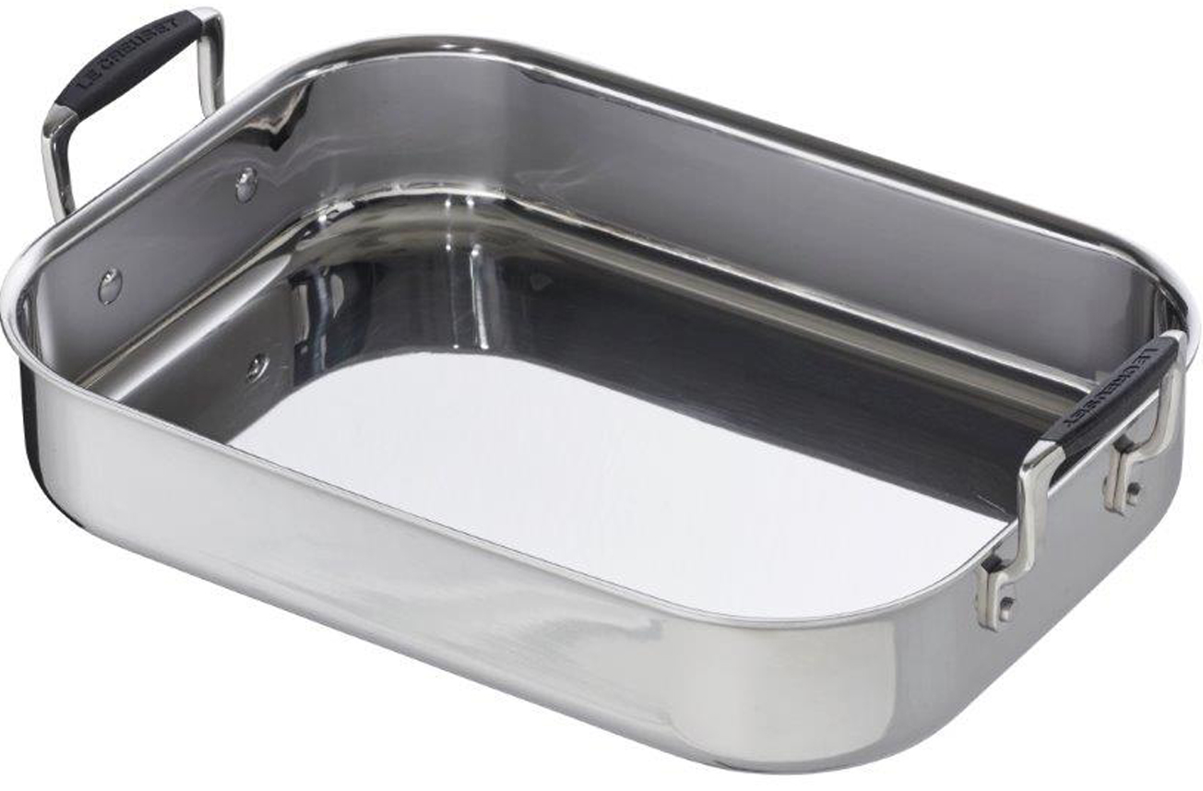
3-Ply Stainless Steel– Available in a selection of Sizes
Saucepan
16cm RRP €155, Kildare price €103.30
18cm RRP €165, Kildare price €110
20cm RRP €175, Kildare price €116.65
35cm Roaster
RRP €225, Kildare price €150
20cm Poaching Pan
RRP €149, Kildare price €99.30

Slide 6
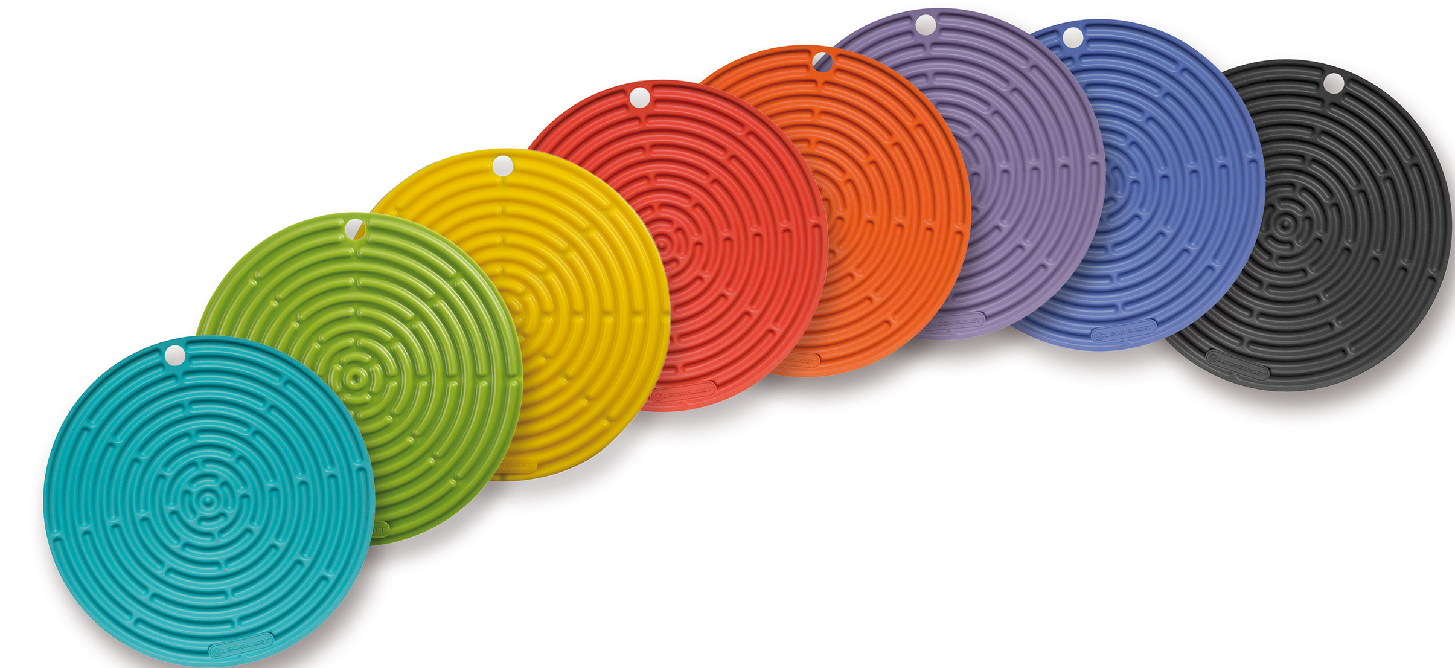
Accessories– Available in a selection of Sizes and Styles
Cool Tool
RRP €18, Kildare price 3 for 2 €36
Stainless Steel Tools Slotted Turner
RRP €45, Kildare price €30
24cm Tongs
RRP €33, Kildare price €22

Slide 7
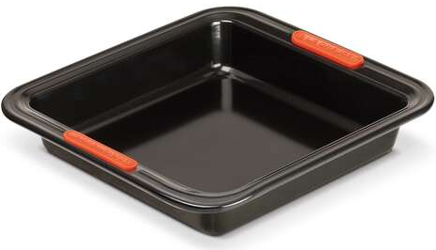
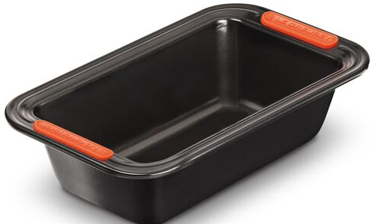
Bakeware – Available in a selection of sizes
12 Cup Muffin Tray
RRP €34, Kildare Price €22.65
23cm Square Cake Tin
RRP €32, Kildare Price €21.30
Loaf Tin
RRP €32, Kildare Price €21.30

